Slide 1
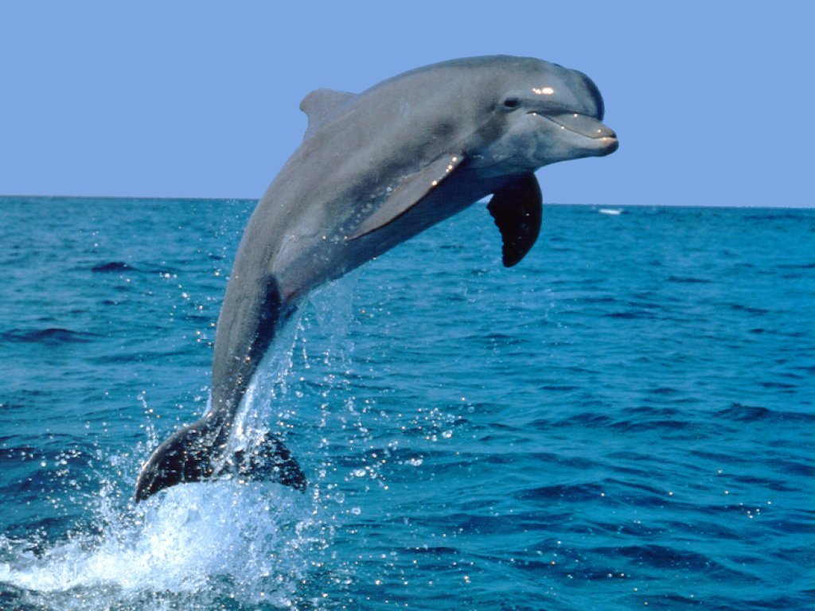
DOLPHIN
Image Processor
Andrew Zysk

Slide 2
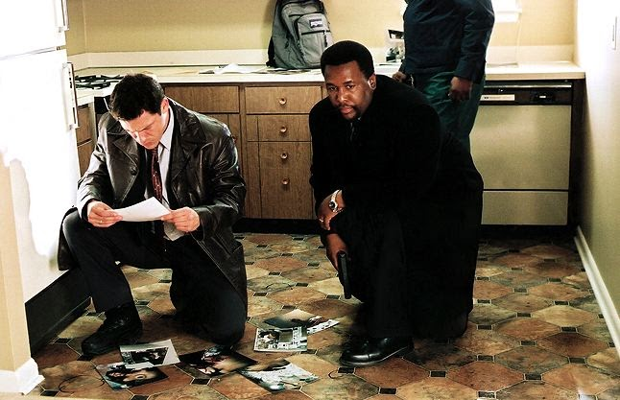
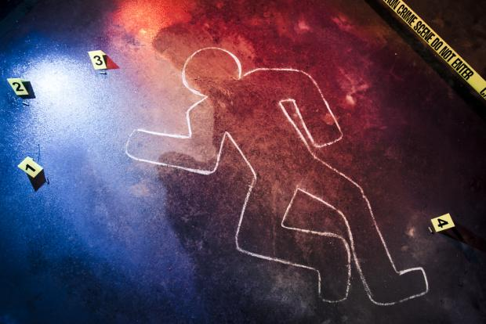
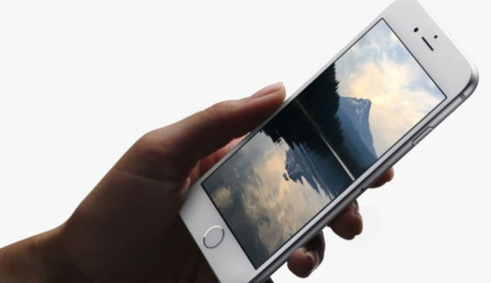
What is Dolphin?
Image Analysis Application
Crime Scene Investigation
User:
Investigators
Detectives
Forensic Scientists
Smart phone
Capture Images
Bloodstains
Debris

Slide 3
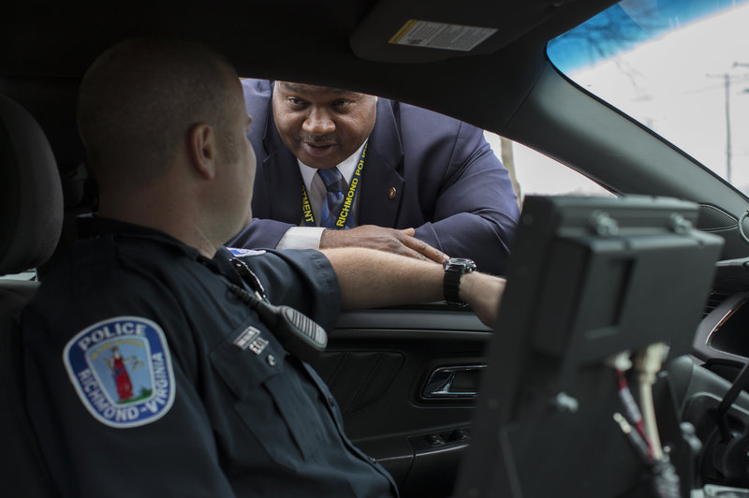
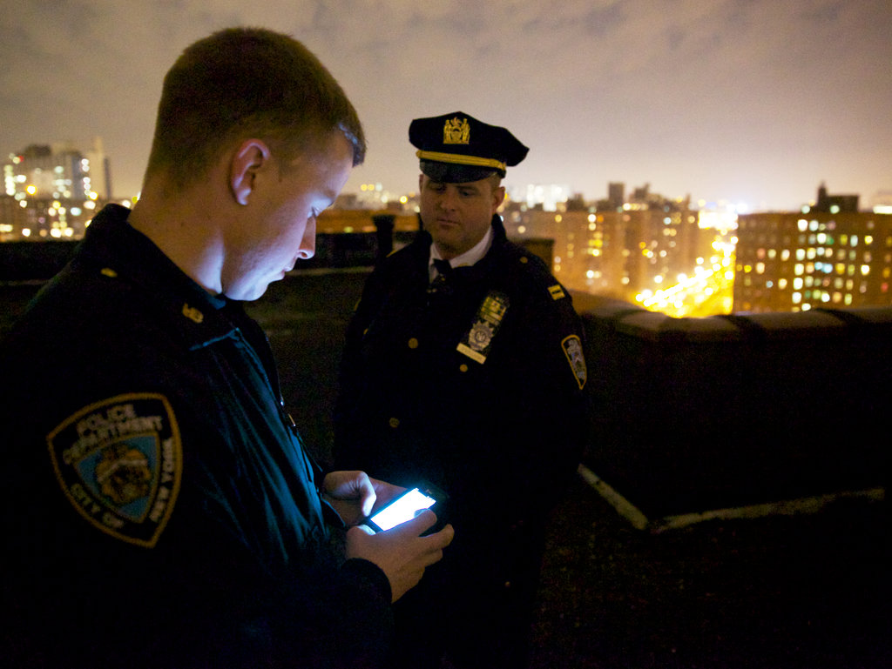
Purpose
1 in 3 murders are unresolved in the US
New analysis tools have benefitted
DNA
Smart phone technology opportunity

Slide 4
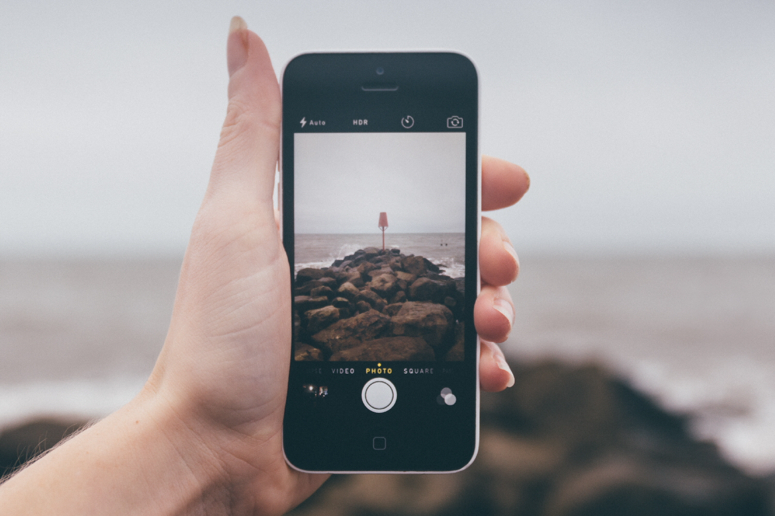

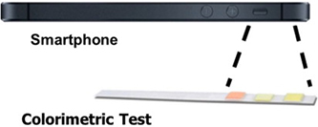
Background
Recent Literature:
Color Calibration
Quantitative Image Analysis
Mobile Smartphone Cameras
Inter-phone algorithms

Slide 5
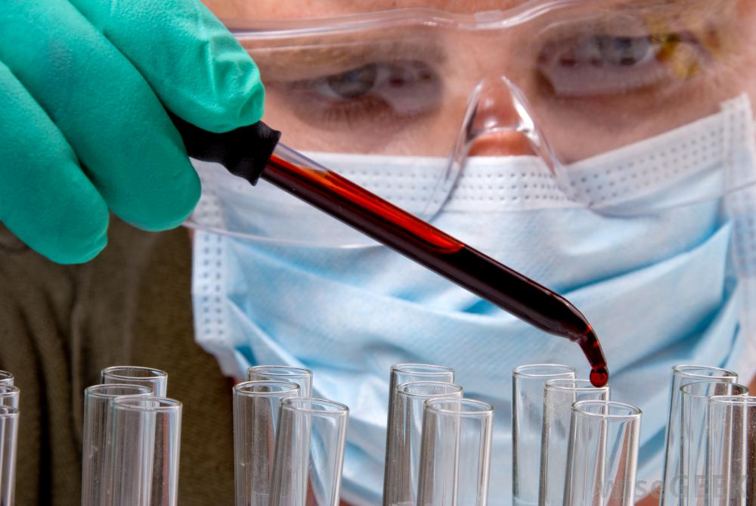
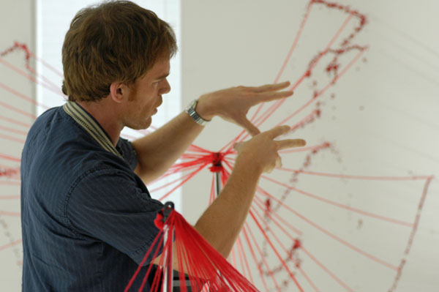
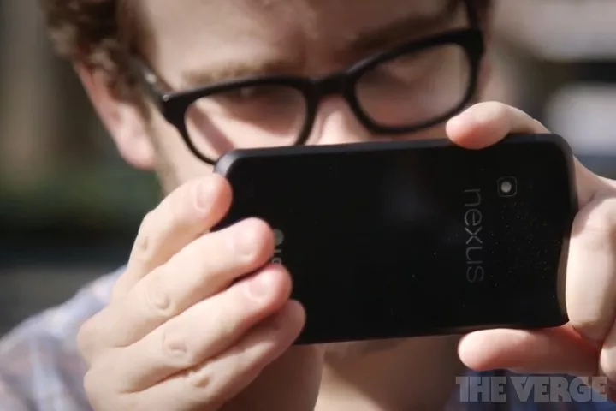
Design
Executive Control
Application suggests parts of the image to analyze
Automate Existing Forensic Techniques
Bloodstain pattern analysis
Ballistic Impact analysis

Slide 6
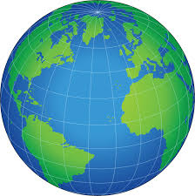
Greater Societal Benefit
Crime Scene Investigation
Improve efficiency of organizations
Low-cost solution
Introduce a new analysis tool
Computer Science and Mobile Technology
Apply smart phone technology in a new way
Algorithmic approach to uncovering the truth
Encourage new smartphone innovations

Slide 7
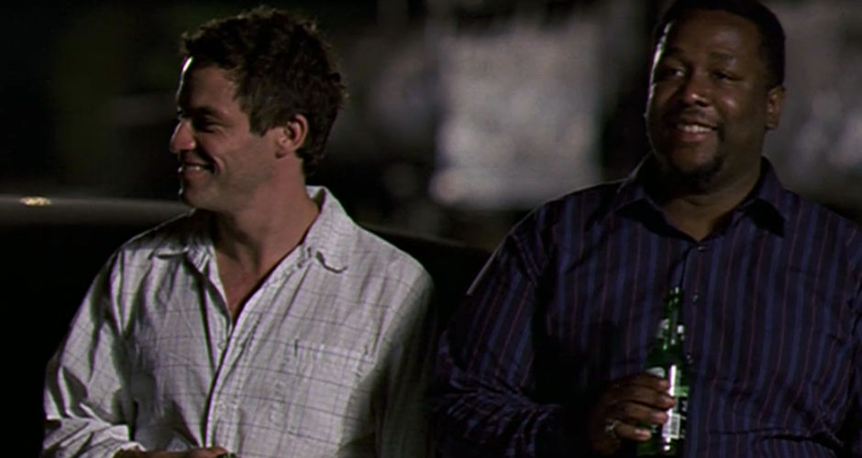
Thank You

